Slide 1

Welcome
To
Cinema

Slide 2
Index
Chapter
Introduction
1.1 Project description
1.2 Project Profile
2. Objectives
3. System Flow Diagram
4. DFD / UML Diagram
5. ER Diagram
6. Database Design
7. System Design
8. References

Slide 3
1.Introduction
1.1 Project Description
❖ Cinema Booking is used to Booking Movies and see the description that which of
the Movies category is needed.
❖ This system is fully responsive or mobile friendly and have a good-looking user interface.
❖ Cinema Booking have contained two panels:
✓ Admin panel
✓ user panel
❖ Admin panel :
✓ It is mandatory to login with an Admin account.
✓ Admin can delete users Accounts.
✓ Admin can add, update or delete Movies.
✓ The login admin can see all users .
✓ Admin can manage or view Movies and user’s messages .
Dashboard: In this section, the admin can see all detail in brief like a total Booking Pending , Booking,
Movies Added, Total users, Admin users, Total Accounts, and New message.

Slide 4
❖ user panel :
✓ It is mandatory to login with a user account.
✓ user can update his / her profile.
✓ user can view which Movies is available in the Cinema.
✓ User can see how many Movies are there.
✓ User can message to admin.
✓ user can see his/her placed Booking.
✓ user can search Movies by search facility.
✓users can his/her log out from accounts.
✓Book: In this section, the user can add the Movies which he/she want to Booking

Slide 5
1.2 Project Profile
Cinema Book
Project Title:- | Cinema Book
Front end:- | HTML,CSS,JavaScript,jQuery
Back end:- | PHP and MySQL
Browser:- | Chrome
Platform:- | VS Code,Xampp
Documentation Tool:- | Power Point
Internal Guide:- | Mr.Mitul Maiyani
Submitted To:- | Mr.Mitul Maiyani

Slide 6
3. System Flow Diagram
Start
Registration
Login
No
Authorized ?
Yes
Is logged in
Mange All Information
Such as:-Users,Read,Update and Delete
Access Information
Logout
Stop

Slide 7
(2).User Process Flow Diagram.
Start
Registration
Login
No
Authorized ?
Yes
Is logged in
See all Movies
See All Categories
Send Message To Admin
And Contcat us
Update Booking and
Delete Booking
Payment and Cancel Payment
Logout
Stop

Slide 8
4.DFD/UML Diagram
* 0 Level Diagram(Context Diagram)
Customer Info
Customer Info
0.0
Cinema Ticket Booking System
Admin
Booking Info
Booking Info
User
Confirmation Info
Confirmation Info

Slide 9
* 1St Level Admin Diagram
Customer Info.
1.1
Manage Customer Info.
Customer Info.
Booking Info
Booking Info
1.2
Manage Booking Records
Accomodation info.
Accomodation List
1.3
Monitor Booking Status
Admin
Booking Confirm
Chosen Location
User
Transaction Info.
1.4
Manage Transactions
Transaction Details
Price Information
Payment Details

Slide 10
* 1st Level User Diagram
Request to login
Send Response
Receive Response
Login
Verify Details
Send Booking Info.
Booking
Store Booking Details
Receive Response
Send Response
User
Admin
Send Payment
Receive Payment
Payment
Receive Response
Send Response
Send Message
Contact
Receive Message
Receive Response
Send Response

Slide 11
5. ER Diagram
User_id
User_email
User_name
Book_id
Book_type
User_mobile
User
Book_desc
Booking
User_Password
Manage
Pay_cust_id
Movie
Pay_desc
Payment
Pay_amt
movie_id
Movie_desc
Movie_cat
Pay_id
movie_image
Pay_date
Movie_name
Movie_hour

Slide 12
6.Database Design
(1).User Table Design
User Table
No | Field Name | Data type | Constaints
1. | Id | int(10) | primary key
2. | user_name | varchar(100) | not null
3. | email | varchar(100) | not null
4. | profile | varchar(100) | null
5. | password | varchar(100) | not null
6. | phone_no | varchar(100) | not null
7. | created_by | int(10) | null
8. | updated_by | int(10) | null
9. | user_type_id | int(10) | index key(null)
10. | created_at | datetime | Not null
11. | updated_at | datetime | Not null
12. | is_active | boolean | not null
13. | Is_deleted | boolean | not null

Slide 13
(2).User Type Table Design
User Type Table
No | Field Name | Data Type | Constraints
1. | id | Int(10) | primary key
2. | type_name | Varchar(20) | not null

Slide 14
(3).Movie Category Table Design
Movie Category Table
No | Field Name | Data Type | Constraints
1. | id | int(10) | primary key
2. | cat_name | varchar(100) | not null
3. | cat_image | varchar(200) | null
4. | cat_desc | longtext | null
5. | created_by | int(10) | null
6. | updated_by | int(10) | null
7. | created_at | datetime | not null
8. | updated_at | datetime | not null
9. | is_active | boolean | not null
10. | is_deleted | boolean | not null

Slide 15
(4).Movie Table Design
Movie Table
No | Field Name | Data Type | Constraints
1. | id | int(10) | primary key
2. | movie_name | varchar(100) | not null
3. | movie_image | varchar(200) | null
4. | movie_desc | longtext | null
5. | category_id | int(20) | index key(null)
6. | release_date | datetime | not null
7. | is_released | boolean | not null
8. | created_by | int(10) | index key
9. | updated_by | int(10) | index key
10. | created_at | datetime | not null
11. | updated_at | datetime | not null
12. | is_active | boolean | not null
13. | is_deleted | boolean | not null

Slide 16
(5).Theatre Table Design
Theatre Table
Id | Field Name | Data Type | Constraints
1. | id | int(10) | primary key
2. | theatre_name | varchar(100) | not null
3. | theatre_image | varchar(200) | null
4. | created_by | int(10) | null
5. | updated_by | int(10) | null
6. | created_at | datetime | not null
7. | updated_at | datetime | not null
8. | is_active | boolean | not null
9. | is_deleted | boolean | not null

Slide 17
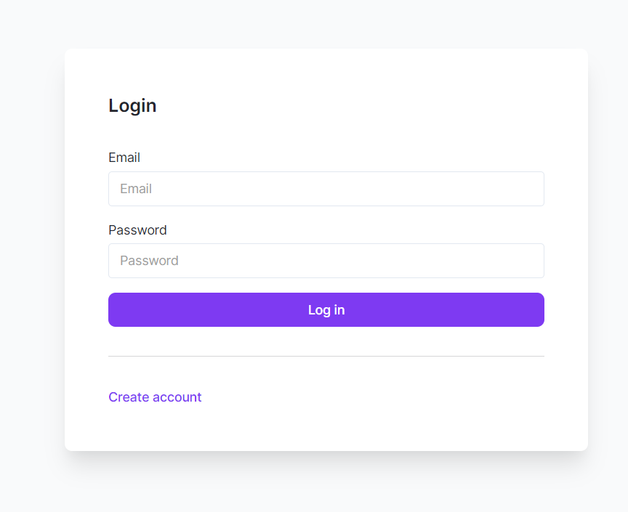
7.System Design
1.Admin Side
(i).Admin Login Page

Slide 18
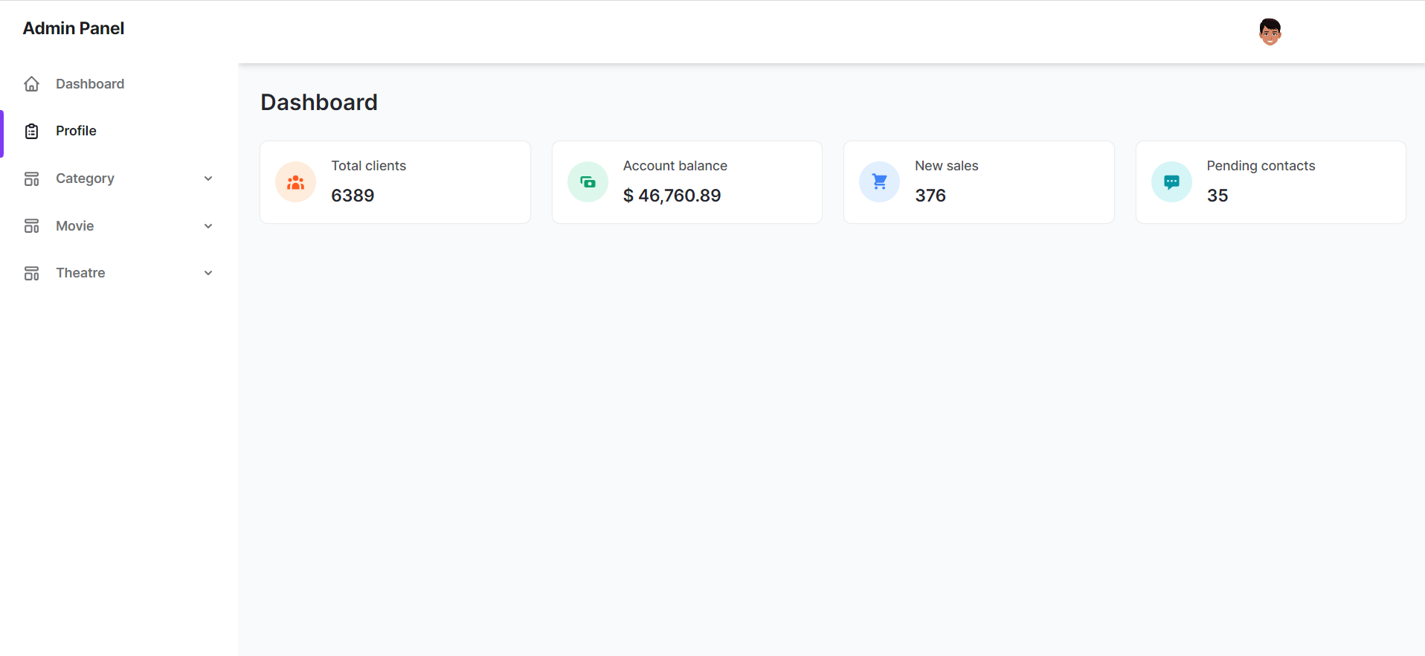
(ii).Dashbord

Slide 19
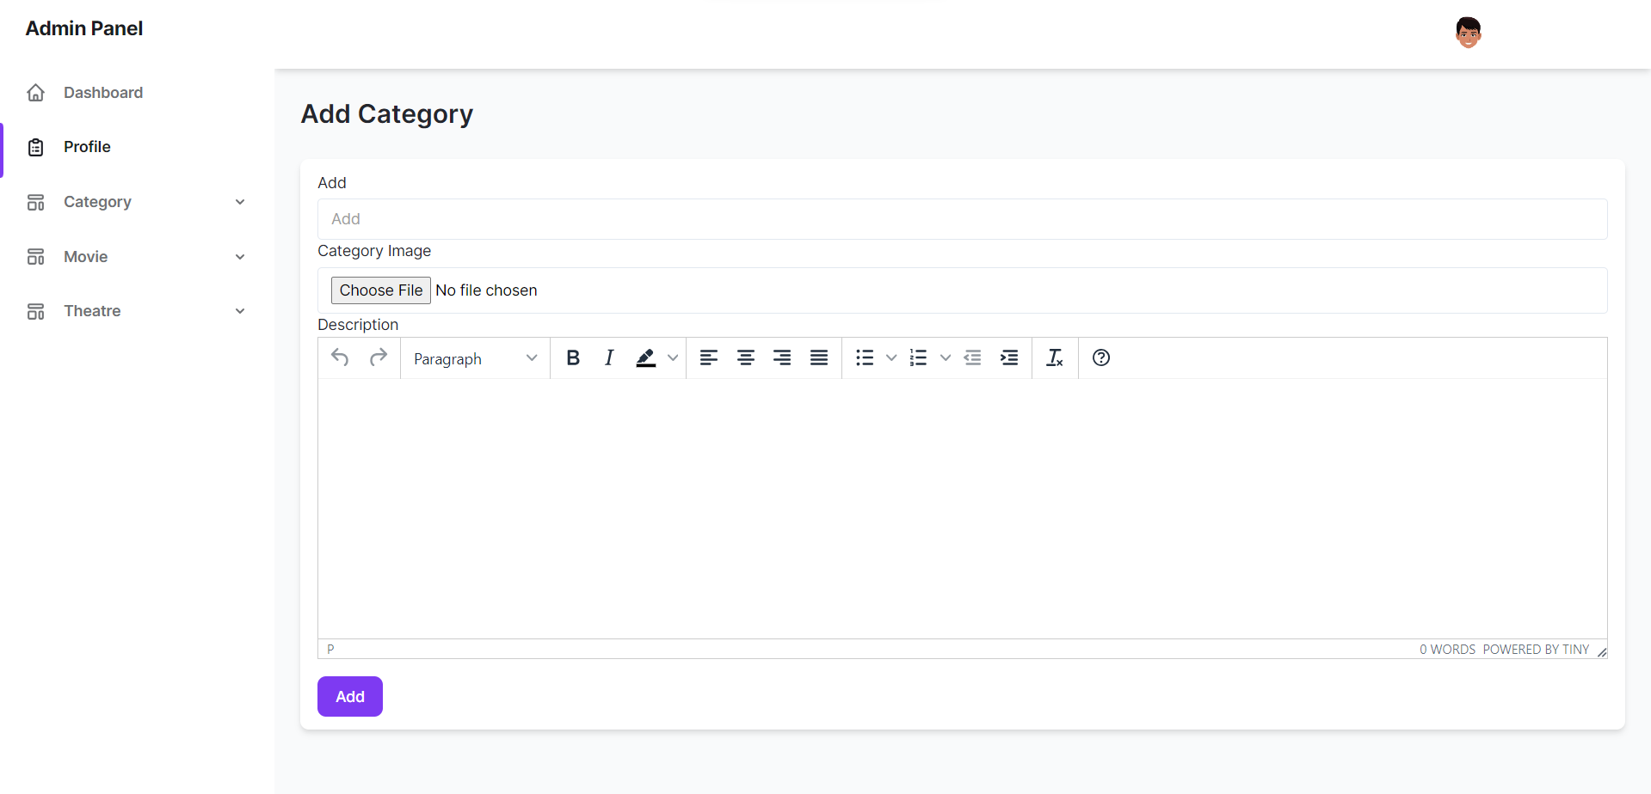
(iii).Category
Add

Slide 20
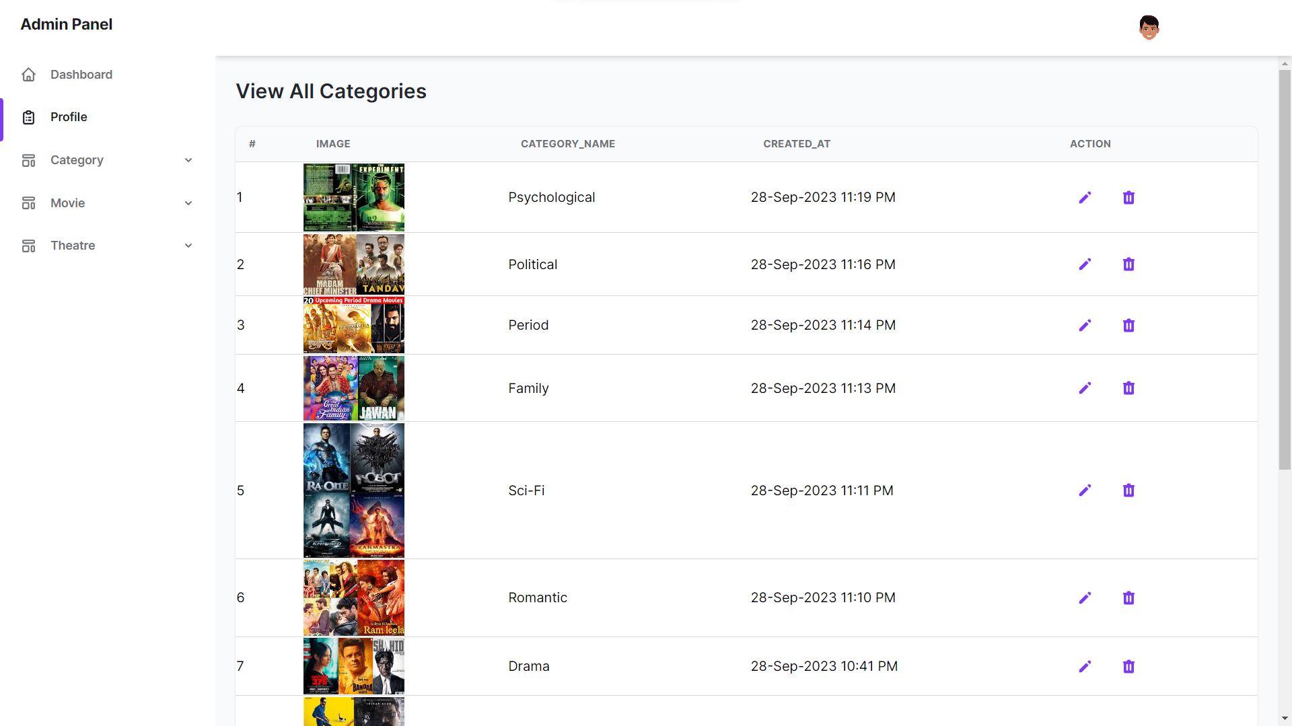
View All Category

Slide 21
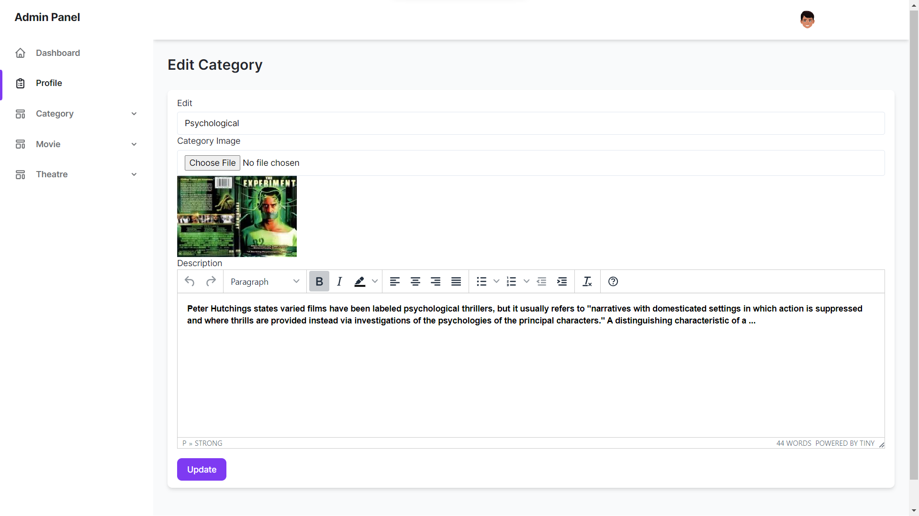
Edit Category

Slide 22
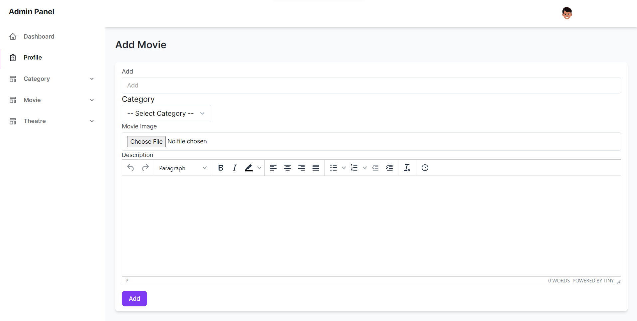
(iv).Movie
Add

Slide 23
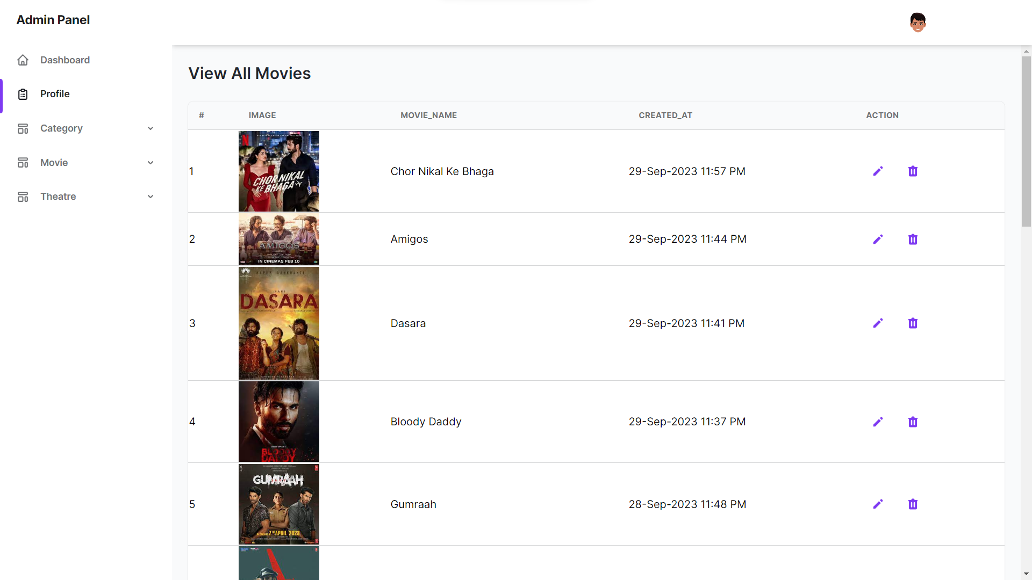
View All Moviesv

Slide 24
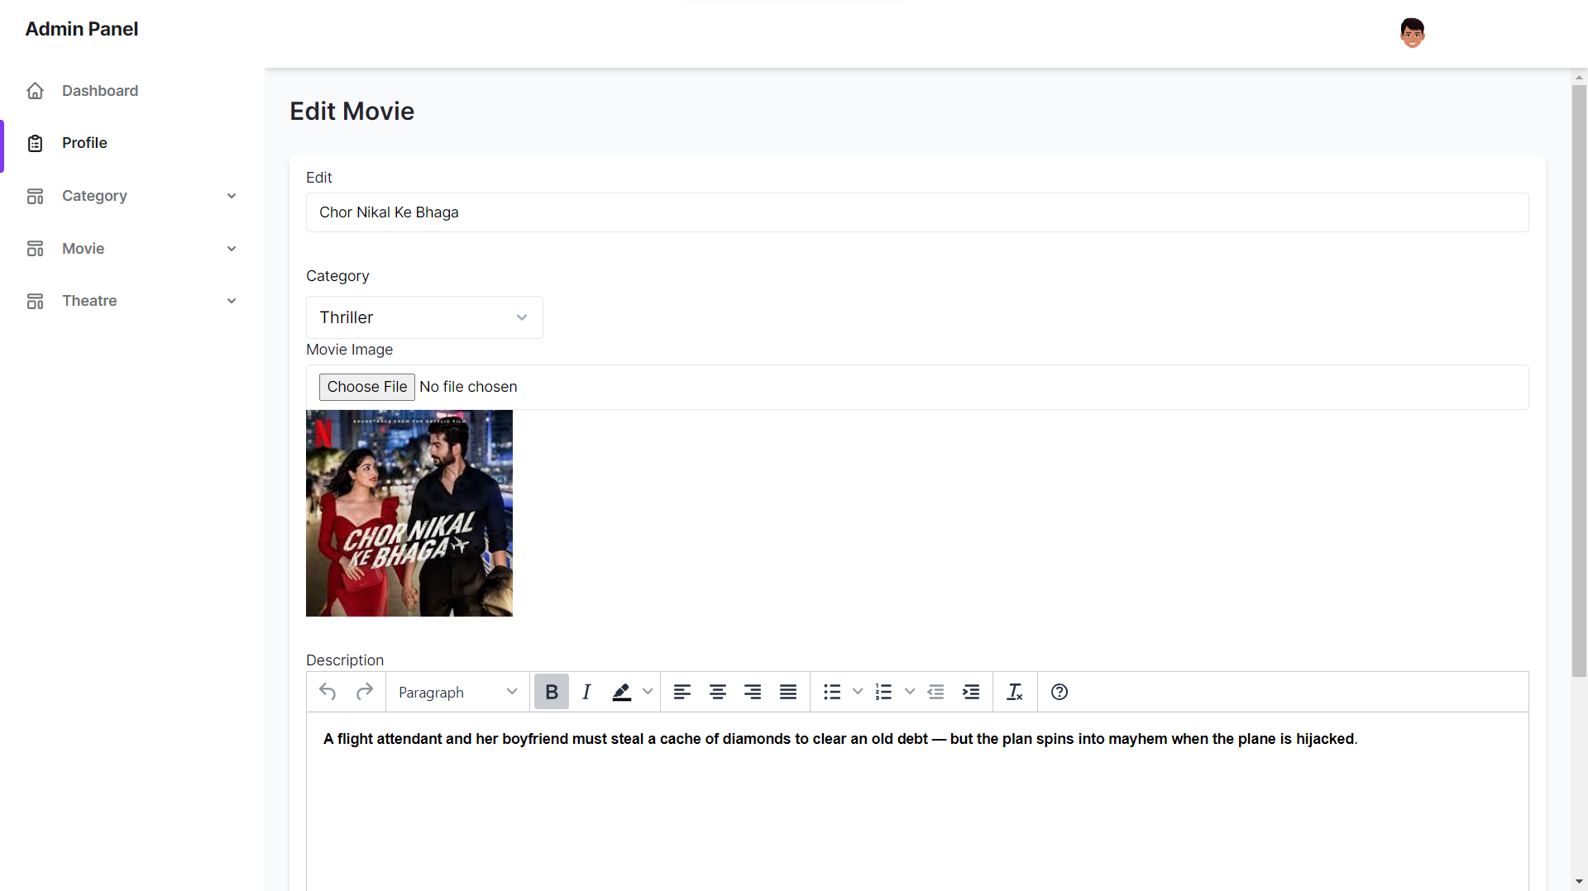
Edit Movie

Slide 25
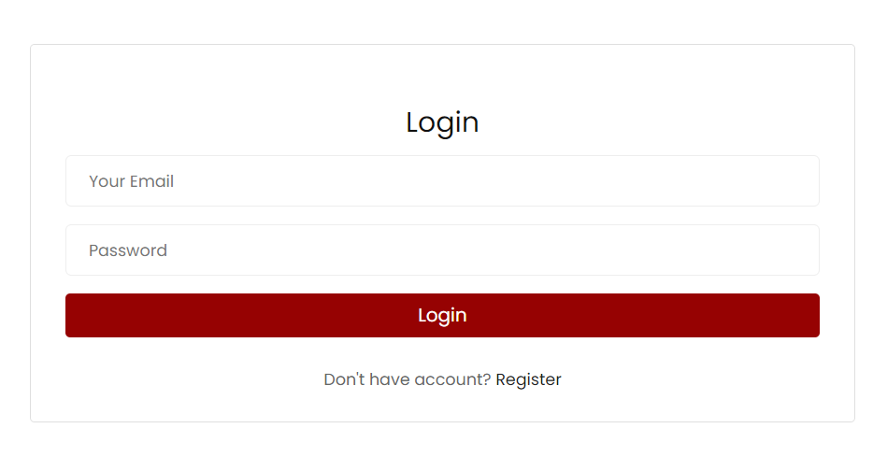
2.User Side
(i).Login Page

Slide 26
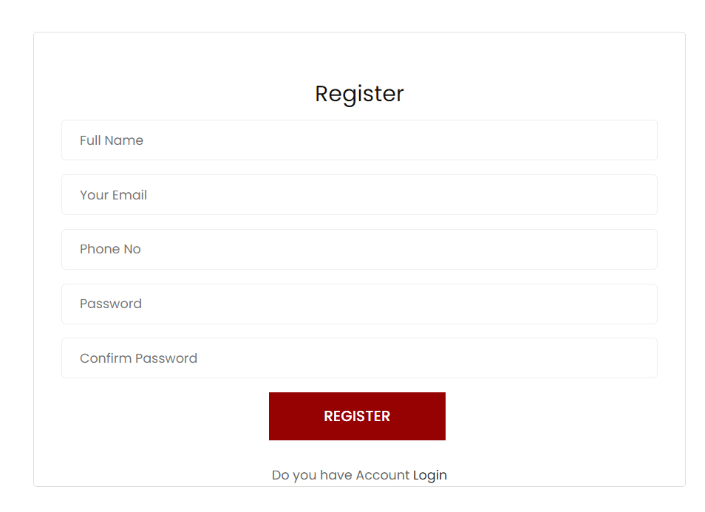
(ii).Register Page

Slide 27
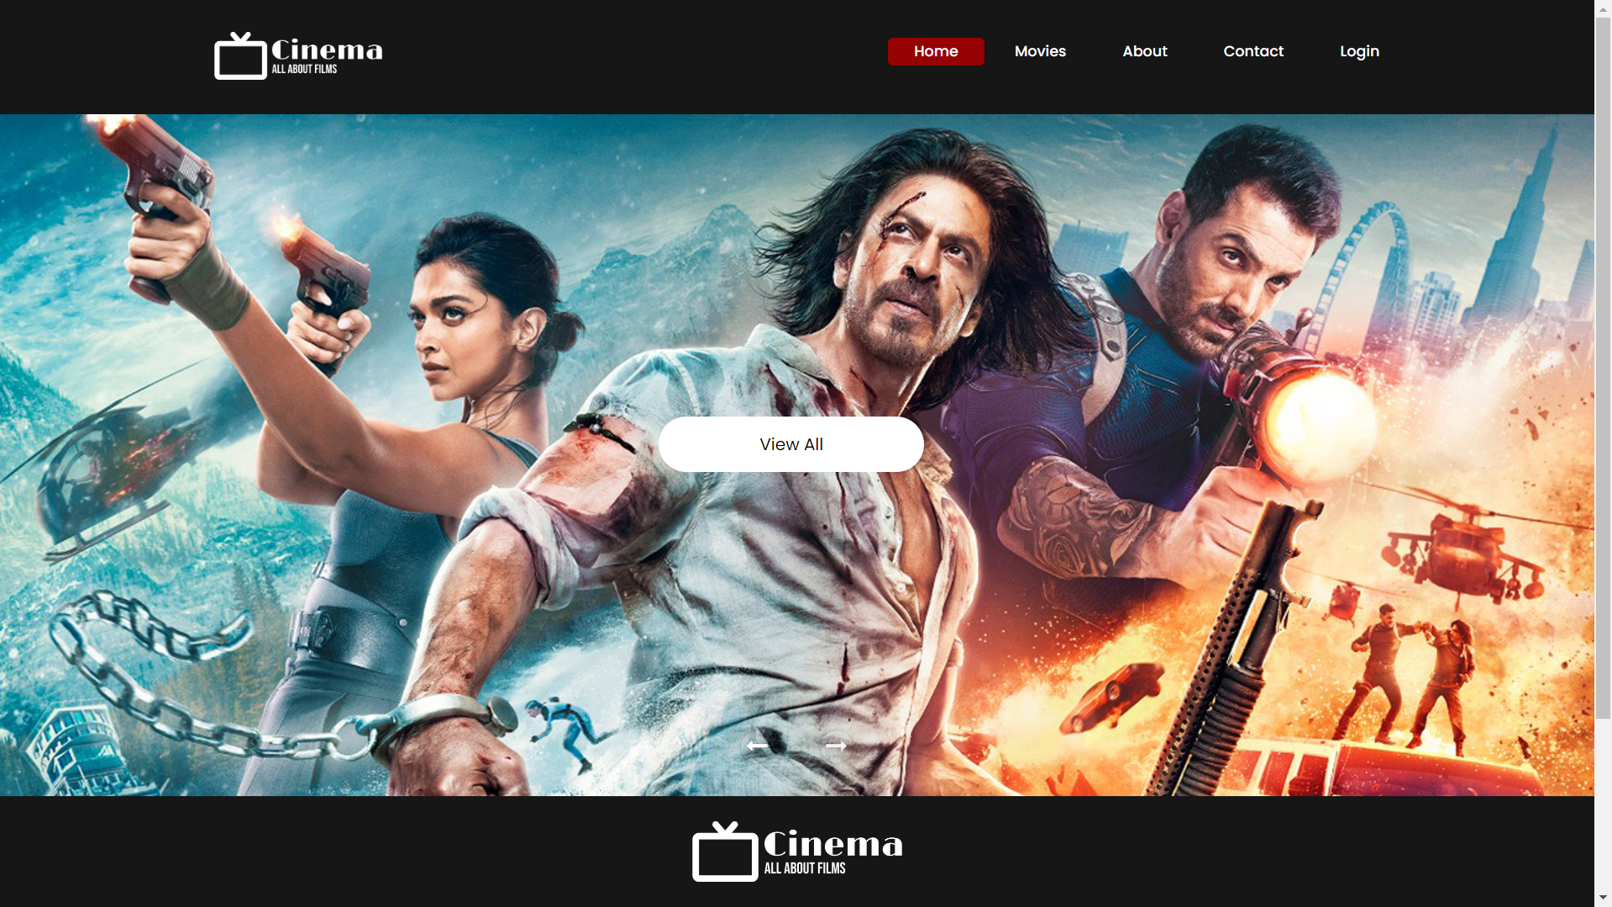
(iii).Home Page

Slide 28
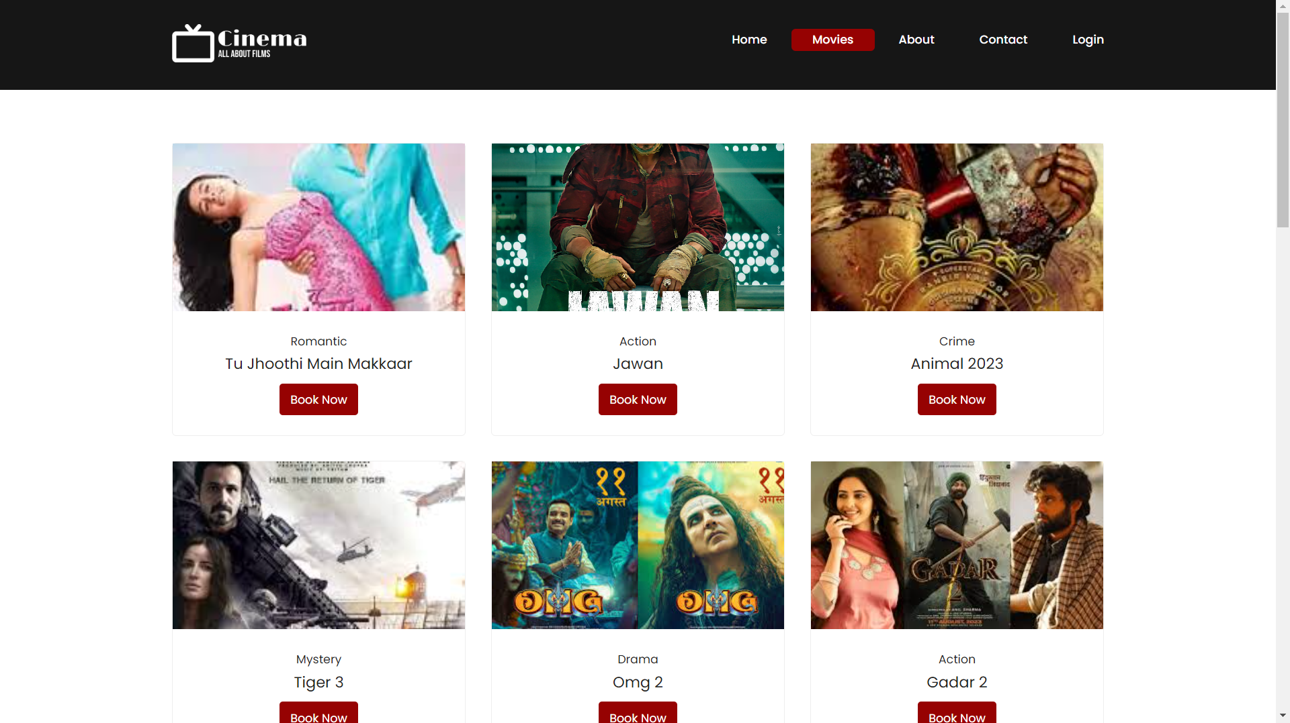
(iv).Movies

Slide 29
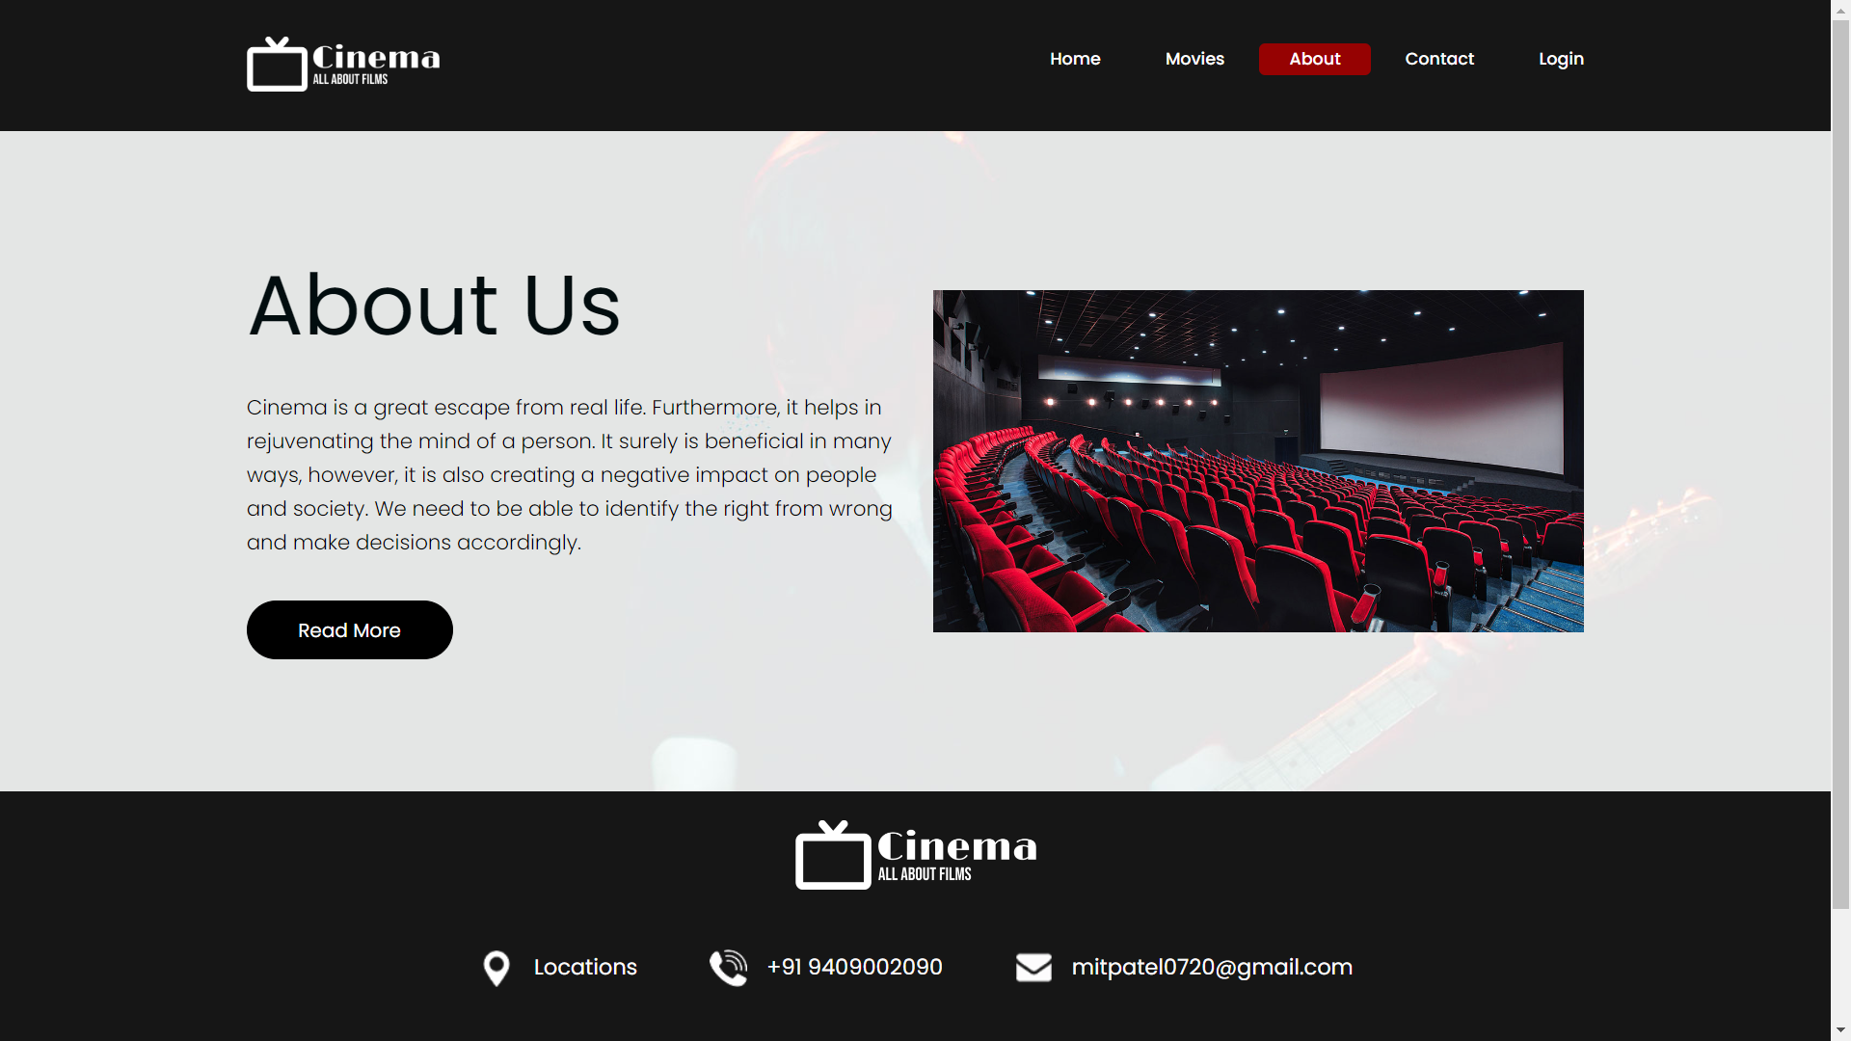
(V).About Us

Slide 30
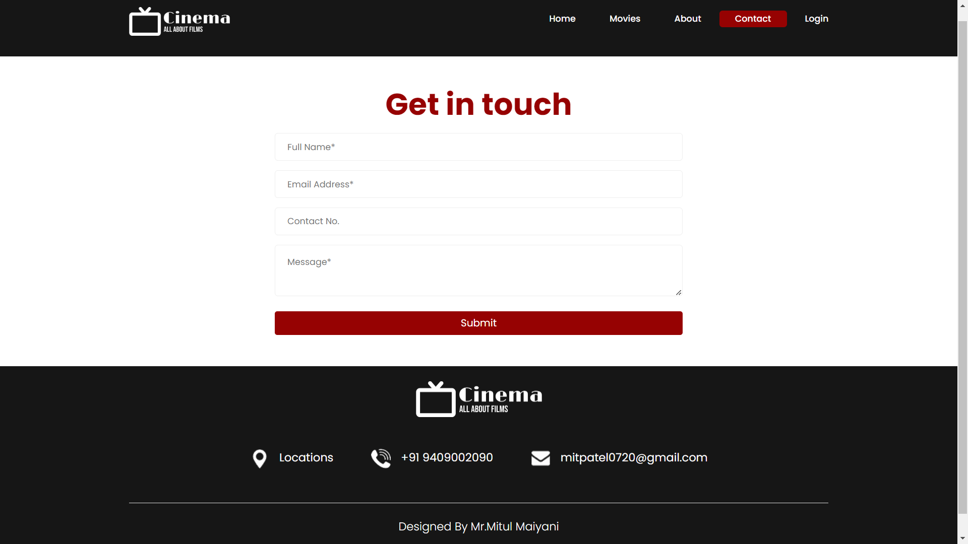
(vi).Contact Us

Slide 31
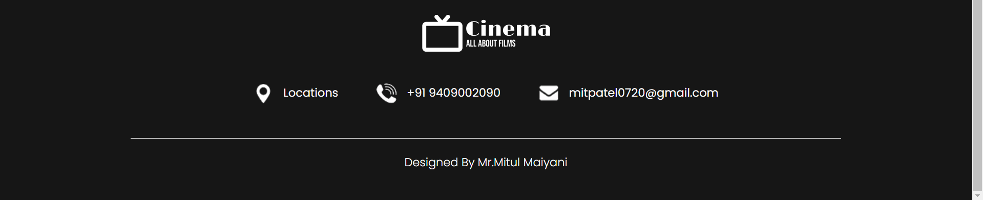
(vii).Footer

Slide 32
8.References
1) https://www.w3schools.com/
2) https://www.geeksforgeeks.org/php-tutorial
3) https://www.javatpoint.com/php-tutorial

Slide 33
Thank
You

